Slide 1



Sultanate of Oman
Sultan Qaboos University
College of Science
Tourism Management Database system in Oman
Done By :
Shahad Al-Gassani | 133140
Khulood Al-Hosni | 136968
Mariam Al-Rashdi | 141535

Slide 2
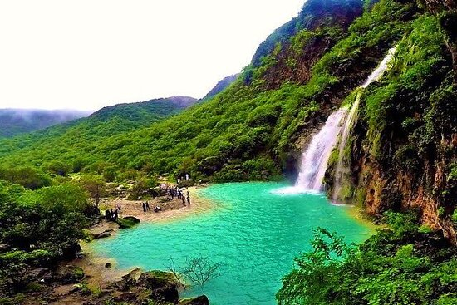
1
Introduction
Outline
2
Problem & Objective
3
EER Model
4
Specialization in EER
5
Advanced SQL Query
6
Conclusion

Slide 3
Tourism Management Database System in Oman
Manages data on Omani tourist attractions, bookings, hotels, and guides
Serves tourists, tour operators, businesses, and government bodies
Supports eco-tourism and real-time updates
Offers personalized experiences to improve tourism planning

Slide 4
Problem
No central system for organizing tourism data in Oman.
Tourists face difficulty in accessing current and trustworthy info on sites, schedules, and facilities.

Slide 5


Objective
Smart Tourism
Data System
Support Sustainable
Tourism

Slide 6
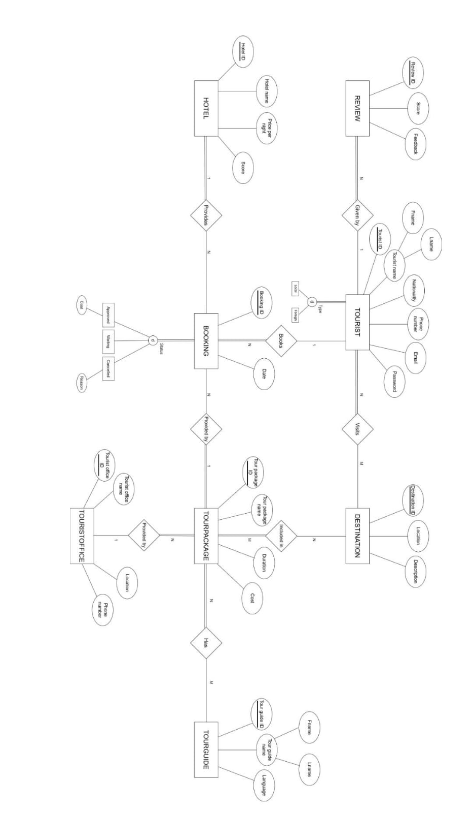
EER

Slide 7
Mapping Option
Mapping Option Used: 8A
Why this choice?
Avoids NULLs for subclass-specific attributes (e.g., Reason, Cost).
Keeps data normalized and reduces redundancy.
Suitable for disjoint and total specializations.

Slide 8
Mapping Option
Why Not Other Options?
8B: Removes main class (Tourist) – breaks relationships like Booking.TouristID.
8C: Merges all into one table – results in many NULLs.
8D: Designed for overlapping, but our specializations are disjoint.

Slide 10
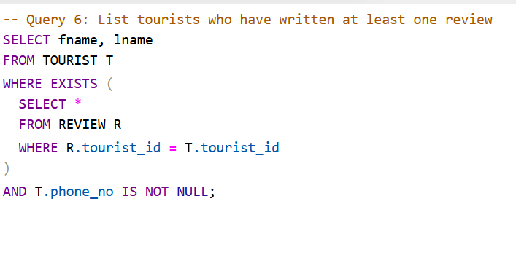
Query
List tourists who have written at least one review

Slide 11
Relational Algebra Expression
Sequence of Relational Algebra Operations:
ρ T (TOURIST)
ρ R (REVIEW)
Tourist_Review ← T ⋈ T.tourist_id = R.tourist_id
Tourist_Phone ← σ (T.phone_no IS NOT NULL) (Tourist_Review)
Result ← π (fname, lname) (Tourist_Phone)
Single In-line Relational Algebra Expression:
π (fname, lname) (σ (phone_no IS NOT NULL) (TOURIST ⋈ REVIEW))

Slide 12
Query Purpose & Objective
How it serves the objective:
Identifies highly engaged tourists.
Useful for reward programs and personalized tour suggestions.
Encourages re-visits and builds tourism loyalty.

Slide 13
Conclusion
What We Learned
How to analyze requirements and design EER diagrams.
How to write SQL, build relational algebra, and optimize queries.
Challenges Faced
Mapping specializations without losing data integrity.
Designing correct and efficient JOIN + nested queries.

Slide 14
THANK YOU

